Slide 1
Soft Triplet Loss : Deep mEtric learning without triplet sampling
Team Name : - SMAI_team
Team Members : - Ashirwad Sinha (2019102035)
Sarthak Ramakrishnan(2019115003)

Slide 2
Introduction :
This paper introduces us about that dml (distance metric learning ) is to learn embeddings that same classes are closer than examples of other classes .
This can be achieved by introducing the concept of soft triplet loss , which is a combination of both triplet loss and softmax loss function .
This paper also explains that softmax loss function is equivalent to a smoothed triplet loss (lambda = 0), where each class has a single center .
It also teaches us about center loss and proxy anchor loss.
It also covers portion of center loss and soft triplet center .
It tells why triplet sampling is not required .

Slide 3
Literature review :
Paper 1 : SoftTriple Loss: Deep Metric Learning Without Triplet Sampling
Paper 2: A TUTORIAL ON DISTANCE METRIC LEARNING: MATHEMATICAL FOUNDATIONS, ALGORITHMS, EXPERIMENTAL ANALYSIS, PROSPECTS AND CHALLENGES .
Paper 3: No Fuss Distance Metric Learning using Proxies
Paper 4: Proxy Anchor Loss for Deep Metric Learning
Paper 5: Proxy Synthesis: Learning with Synthetic Classes for Deep Metric Learning (important)
Paper 6: Triplet-Center Loss Based Deep Embedding Learning Method for Speaker Verification (important)

Slide 4
Distance metric learning (DML)
Distance metric learning is a branch of machine learning that aims to learn distances from data which enhances performances of similarity based algorithms .
There are three types of mathematical foundation of distance metric learning : -
Convex analysis
Matrix analysis
Information theory
In this paper they have used convex analysis for calculating dml .

Slide 5
Learning with proxies
learning with only the training data can be overfitted to the seen classes, leading to the lack of generalization capability on unseen classes.
To address this problem, we propose a simple regularizer called Proxy Synthesis that exploits synthetic classes for stronger generalization in deep metric learning.
This method generates synthetic embeddings and proxies that work as synthetic classes, and they mimic unseen classes when computing proxy-based losses.
There are two types of proxy synthesis : -
Pair-based loss
Proxy-based loss

Slide 6
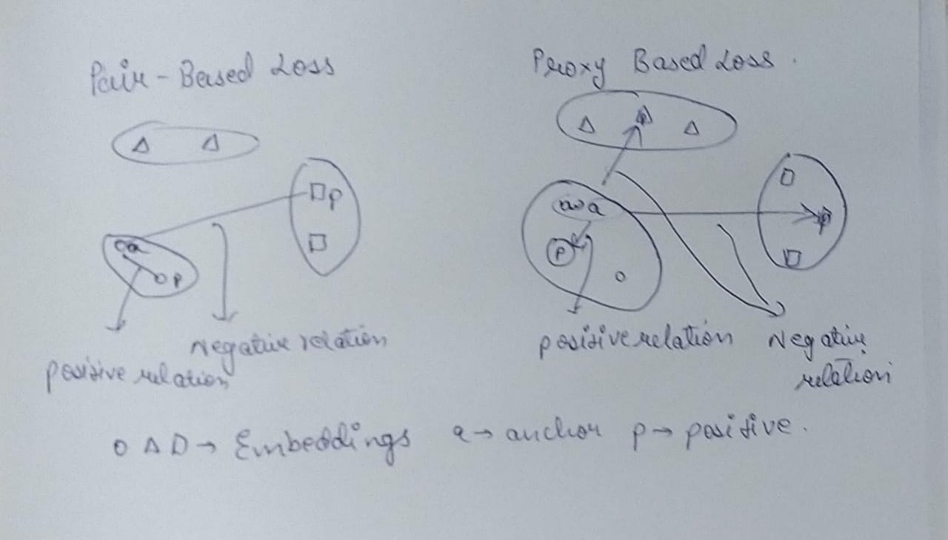
Pair based loss and proxy based loss
Pair based loss | Proxy based loss
It pulls samples from same class | It pulls anchor and positive proxy
It pushes samples from different class | It push anchor and all negative proxies .

Slide 7
Motivation of proxy based method: -
The purpose of dml is to construct well generated embedding space on both train(seen) and test (unseen) classes .
This can lead to overfitting with seen classes leading to lack of generalization on unseen classes .
This is done by combination of pair based loss and proxy based loss methods .

Slide 8
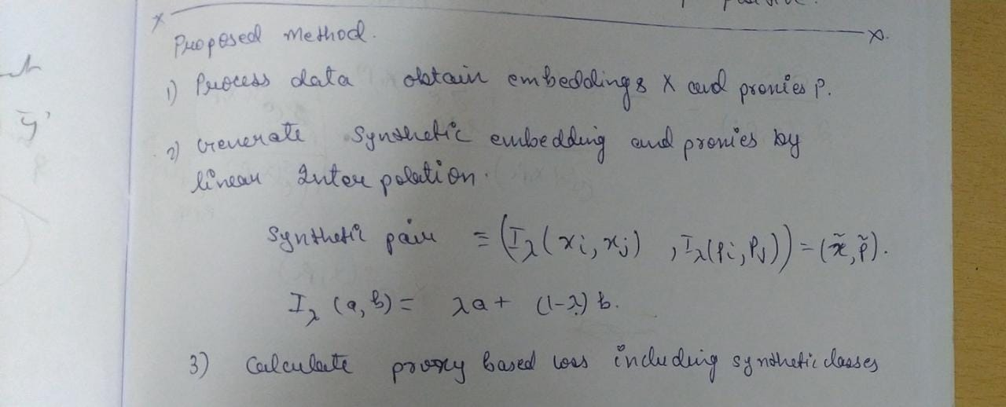
MATHS for proxy analysis

Slide 9
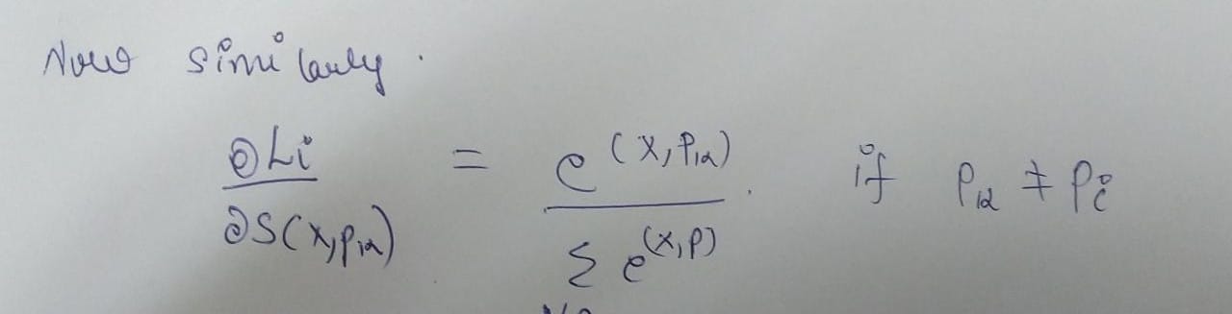
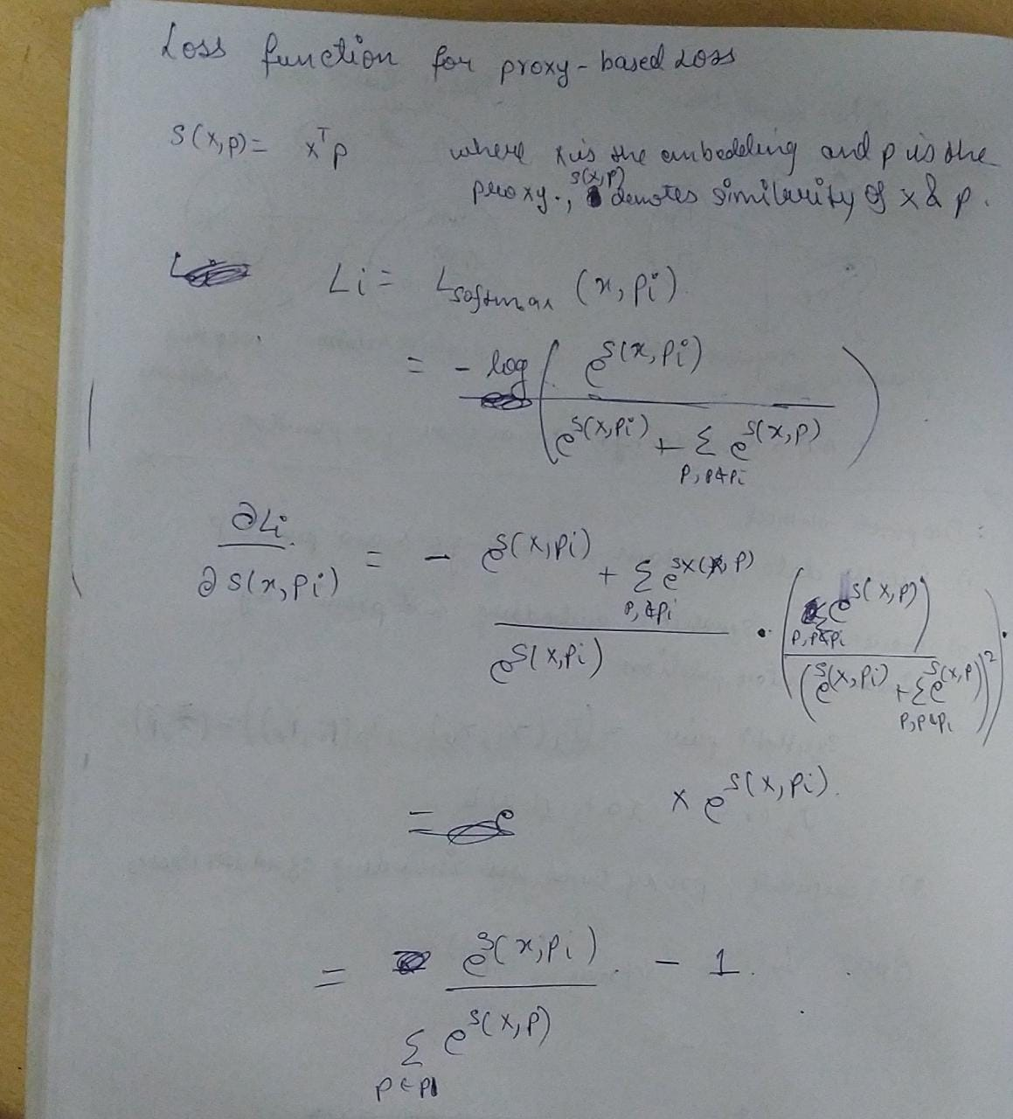

Slide 10
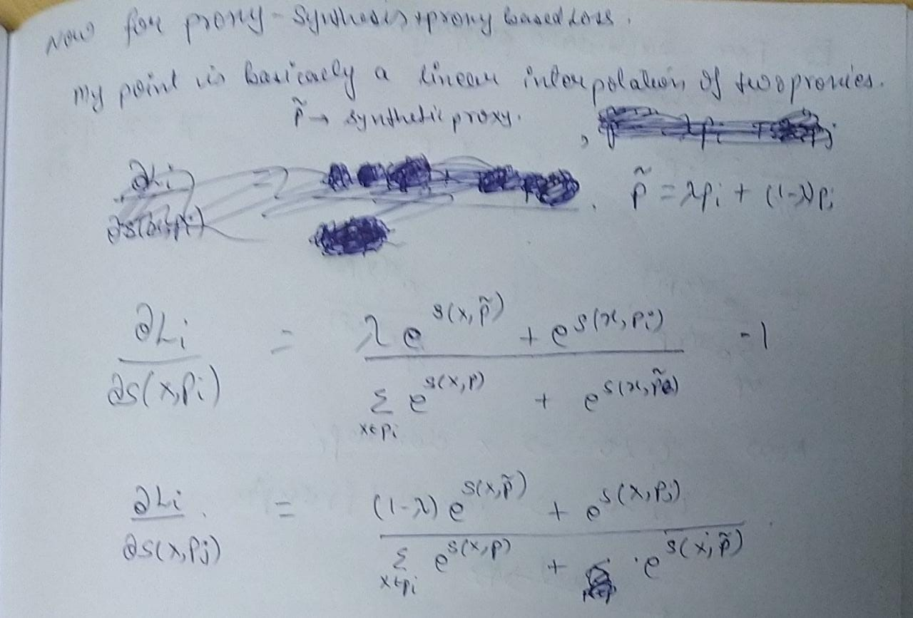

Slide 11
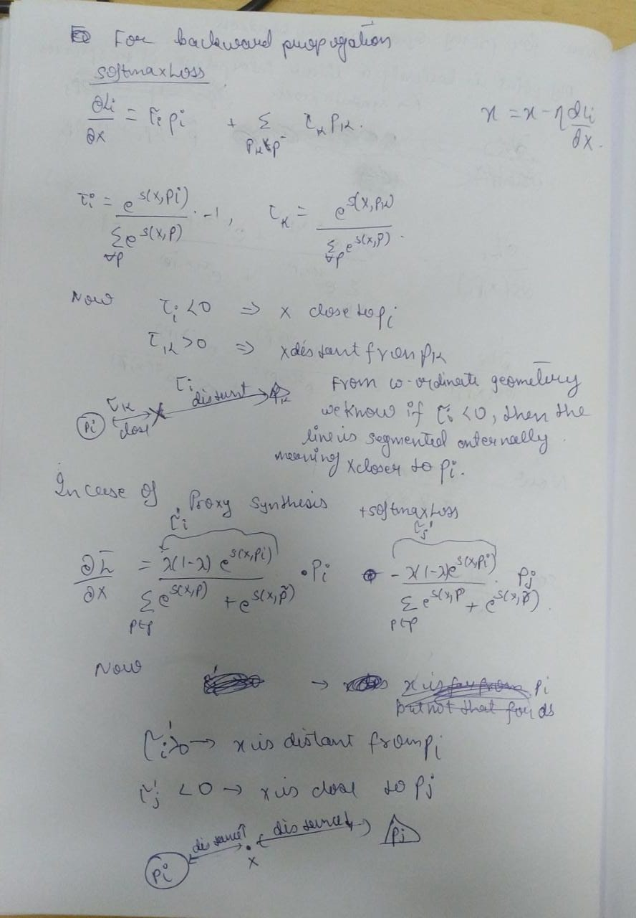

Slide 12
Conclusion of proxy loss : -
It introducing synthetic classes proxy loss is trying not to overfit to training data .
Due to this a well structured embedding space is created , eg : -
King - man + woman = queen , this type of relationals embeddings are created .
It is more effective than softmax loss function .
It creates a generalised DML which is important for any analysis .

Slide 13
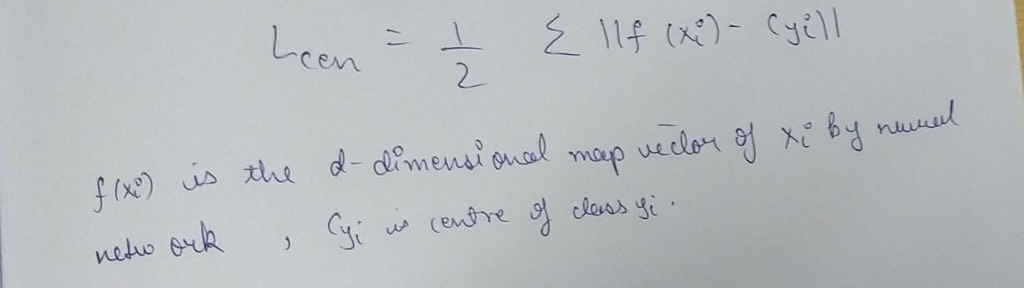
Center loss
It learns a center for each class.It pulls samples close to their corresponding center which belongs to the same class .
Thus the learning goal is to minimize the distances between samples and centers from the same class.

Slide 14
Center loss vs proxy :
center loss only compacts the intra-class variability .
It does not considers inter-class separability , which was considered by proxy loss .
the model must be trained based on the combination of center loss and softmax loss.

Slide 15
Triplets loss and its limitation :
Triplet loss consists of an anchor , positive and negative .
It’s task is to maximise the distance between negative and anchor and minimise the distance between anchor and positive .
It is more or less similar to proxy loss .
The time complexity of triplet loss is o(n^3) which is very huge and problematic .

Slide 16
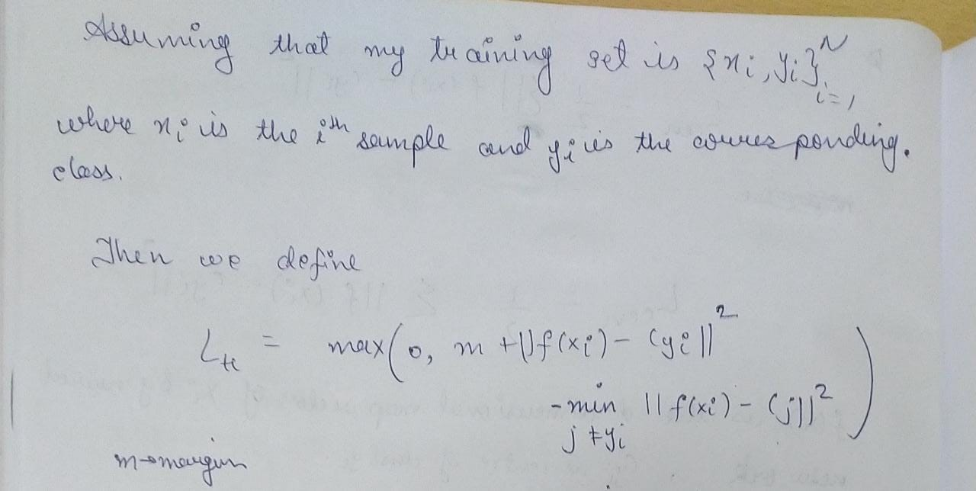
Trilet center loss

Slide 17
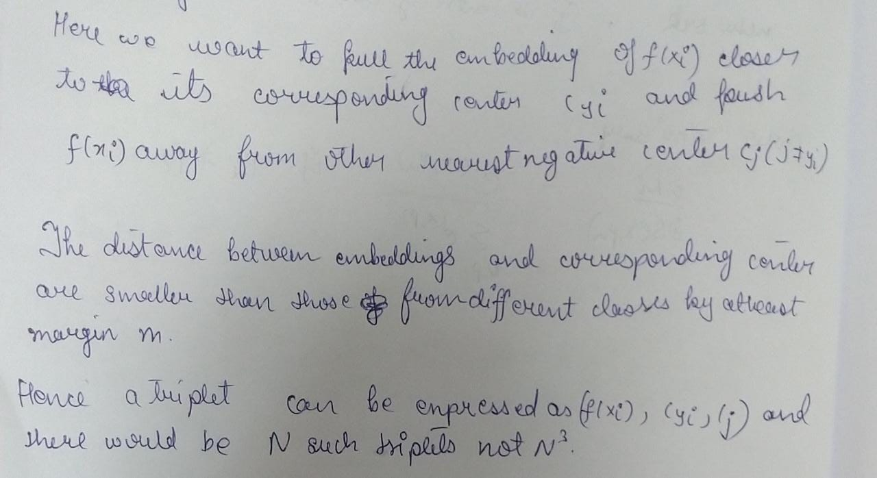
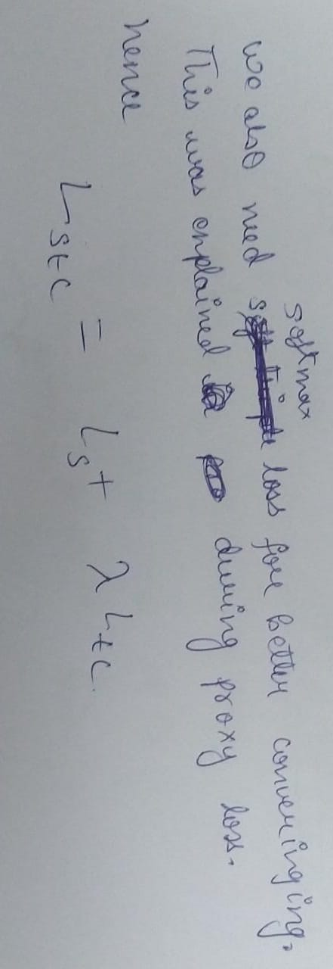

Slide 18
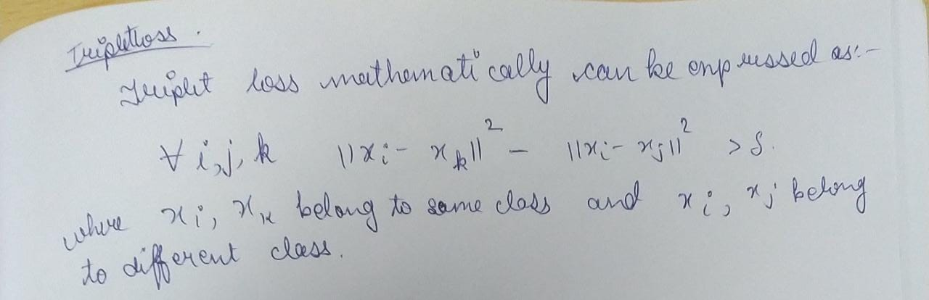
Triplet loss
Triple loss consists of an anchor , positive and negative .
The goal is to minimise distance between anchor and positive and maximise distance between anchor and negative .
Mathematically it can be represented as : -

Slide 19
Using KKt conditions and convex optimisation methods the author that optimizing a smoothed triplet loss is equivalent to minimize a SoftMax loss.
By using a mathematical formulation based on SoftMax, this loss eliminates the sampling needed in the triple loss (for picking the anchor, positive and negative image). Moreover, it extends the idea of multiple “centers”, where the “centers” can be, for example, training samples (like in N-Shot learning).
He then calculated relaxed similarity and soft triple loss .

Slide 20
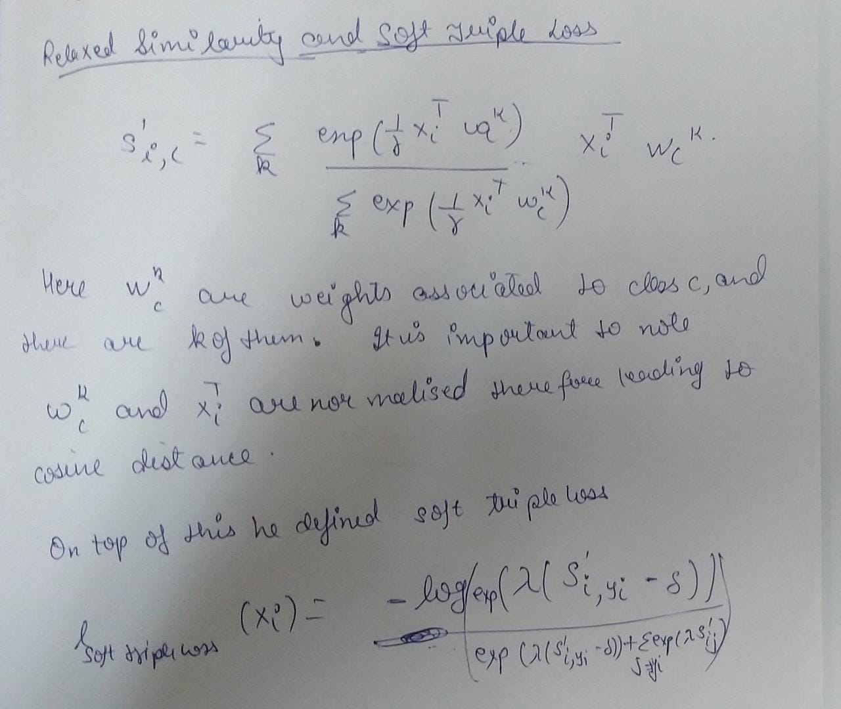

Slide 21
Inferences
optimizing the triplets consisting of centers with a margin δ can reserve the large margin property on the original triplet constraints .
It also implies that more centers can be helpful to reduce the intraclass variance .
In the extreme case that the number of centers is equal to the number of examples, intra - class variance becomes zero. However, adding more centers will increase the size of the last fully connected layer and make the optimization slow and computation expensive. Besides, it may incur the overfitting problem.

Slide 22
Results
The paper used two metric for comparing results with softmax triple loss proxy loss and proxy .
Recall@k = (# of recommended items @k that are relevant) / (total # of relevant items)
NMI is a variant of a common measure in information theory called Mutual Information. Mutual Information accounts to the “amount of information” one can extract from a distribution regarding a second one.
NMi ( y,c ) = (2* i(y,c)) / (h(y) + h(c))
Where i(y,c) = mutual information between y and c
And h(y) and H(c) is entropy of label and entropy of clustered set .

Slide 23
For 64 dimension embedding
 | recall@1 | recall@2 | recall@4 | recall@8 | NMI
Soft max | 76.8 | 85.6 | 91.3 | 94.2 | 66.7
Proxy NCA | 73.2 | 82.4 | 86.4 | 88.7 | 64.9
Soft triple | 77.9 | 88.6 | 92.1 | 95.4 | 67.1
For 512 dimension embedding
 | Recall @ 1 | Recall @ 2 | Recall @ 4 | Recall @ 8 | NMI
Soft triple | 76.77 | 85.3 | 90.9 | 94.8 | 66.2

Slide 24
For different number of centers
 | Recall @1 | Recall @2 | Recall @4 | Recall @8 | NMI
K = 2 | 76.7 | 85.3 | 90.9 | 94.8 | 66.2
K = 6 | 77.3 | 85.9 | 91.5 | 95.3 | 67.4
K = 10 | 76.9 | 85.0 | 91.0 | 94.7 | 66.4
THE ABOVE RESULTS CAN BE FOUND AT LINK : - https://iiitaphyd-my.sharepoint.com/:u:/g/personal/sarthak_agrawal_research_iiit_ac_in/EZ2K4p_LcDpHm_7YQFlN0poBi9II7BKjvvcAKqWZu2qszQ?e=RcXjV1
HERE WE CAN ALSO DEE THAT AS WE ARE INCREASING THE centers the recall score and nmi both are improving which clearly indicates that by increasing the number of center the intra class variance decreases leading to better results .

Slide 25
contribution
Ashirwad sinha (2019102035) - literature and mathematical analysis
Sarthak ramakrishnan((2019115003) - training and testing

Slide 26
THANK YOU !!!!!!!!!!!!!!

